Slide 1

ORGANİCUS
Istanbul Technical University BLG 411E - Software Engineering Fall 2020 Group 11
Notes:
Neslihan Çekiç 150160060
Merve Candan 150160041
Yarkın Söyler 150160018
Onur Aydın 150160135
Anıl Zeybek 150190705

Slide 2
Contents
Project
1. Introduction
2. System Describing
3. Our Team
4. Technologies
5. Our Customer Meetings
6. Test & Results
7. Conclusion
Live Demo

Slide 3
1.1) Introduction
Organic food consumption time for everyone!
Availability and prices of organic products can be discussed nowadays.
There are a lot of people in our country, who produce food with their own means.
Especially housewives and small farmers.
Many of them trying to sell their homemade products for different purposes mostly via social media.
But social media have many aspects, unfortunately their attempts often fail.

Slide 4
1.1) Introduction
Our goal is designing a web platform specifies for these purposes.
In our platform, the producers can display all of their products to customer.
Unlike in social media, customers who only want to buy or look organic / homemade products visit our platform.
People who have trouble making themselves heard thanks to our platform, will not have trouble anymore.

Slide 5
1.1) Introduction
Our platform contains predetermined categories.
Producers can add their products into these categories and display their products.
Producers and customers can be in contact during the ordering and after buying process.
Prices can be set by producers but always in control of authorities.
There is also a rate / comment system, so successful producers will be rewarded in this way.

Slide 6
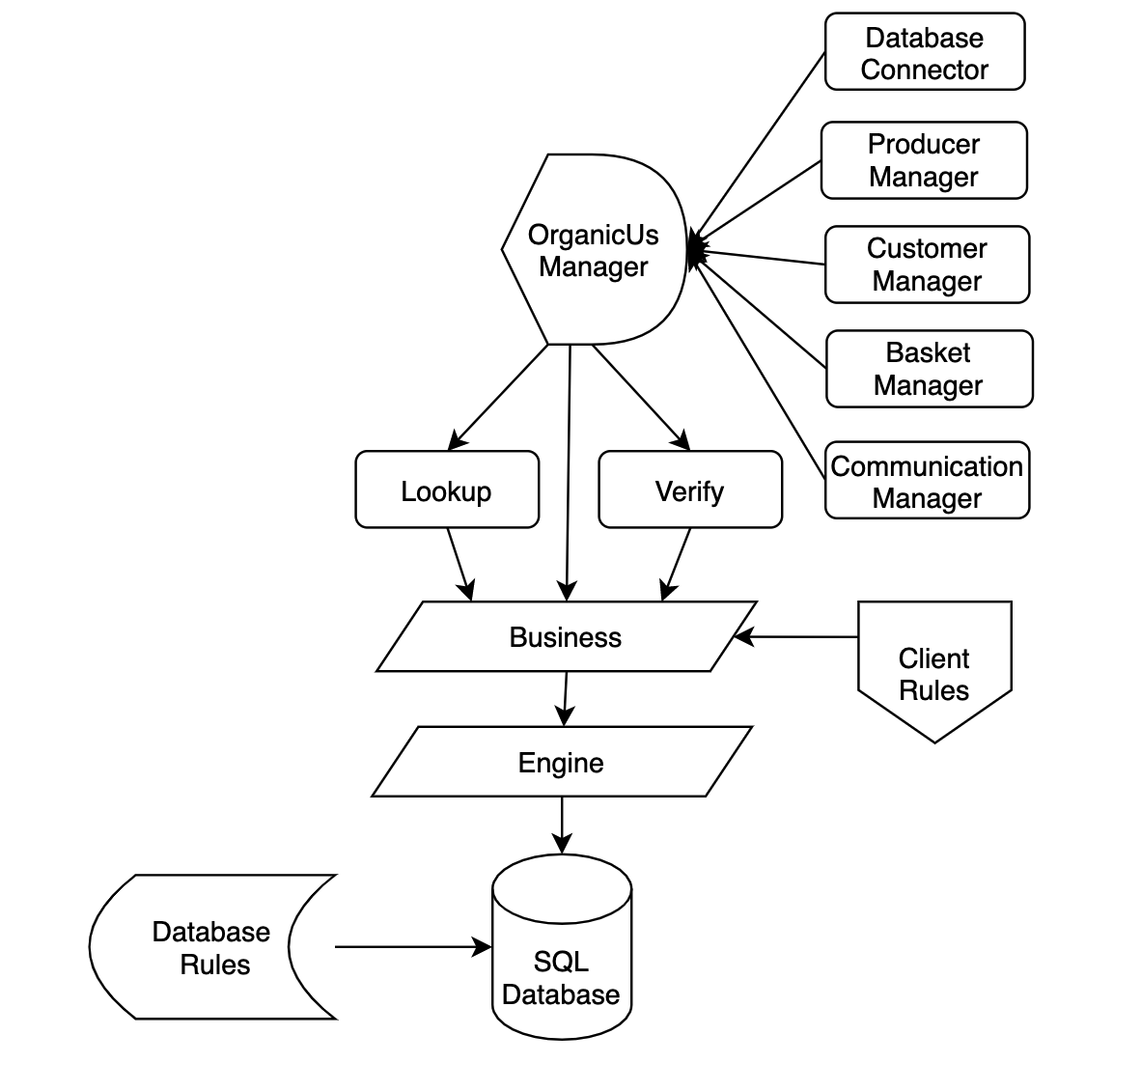
1.2) System Describing
System Architecture Diagram

Slide 7
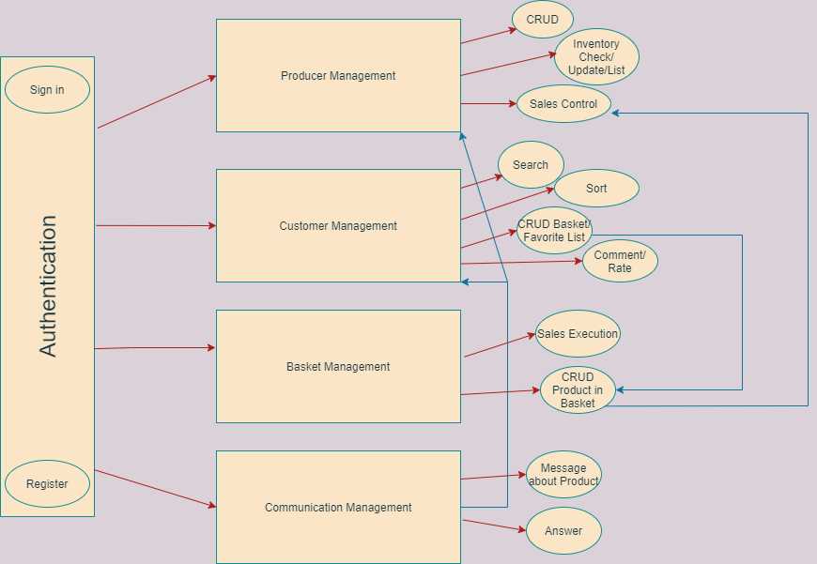
1.2) System Describing
Use Case Diagram

Slide 8
1.3) Our Team
Neslihan Çekiç 150160060
Inventory Management
Authentication System
Full-Stack Developer
Anıl Zeybek 150190705
Basket and Order Management
Back-End Developer and Test Engineer
Onur Aydın 150160135
Customer Management
Back-end Developer and Product Manager
Merve Candan 150160041
Communication Management
Back-End Developer and Test Engineer
Yarkın Söyler 150160018
Customer Management
Back-end Developer and Product Manager

Slide 9
1.4) Technologies
Project Tracking and Management Tool : JIRA
Documentation Tool : Confluence
Source Code Version Tools : Bitbucket & Sourcetree
Testing Tools : Jest & Supertest
MERN Stack

Slide 10
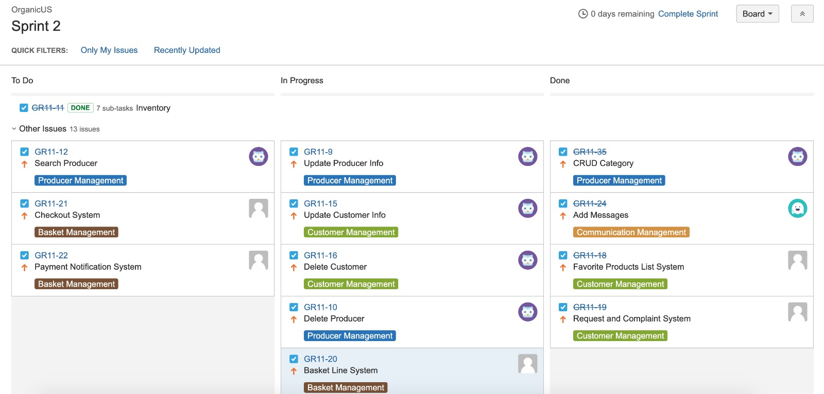
1.4.1) JIRA

Slide 11
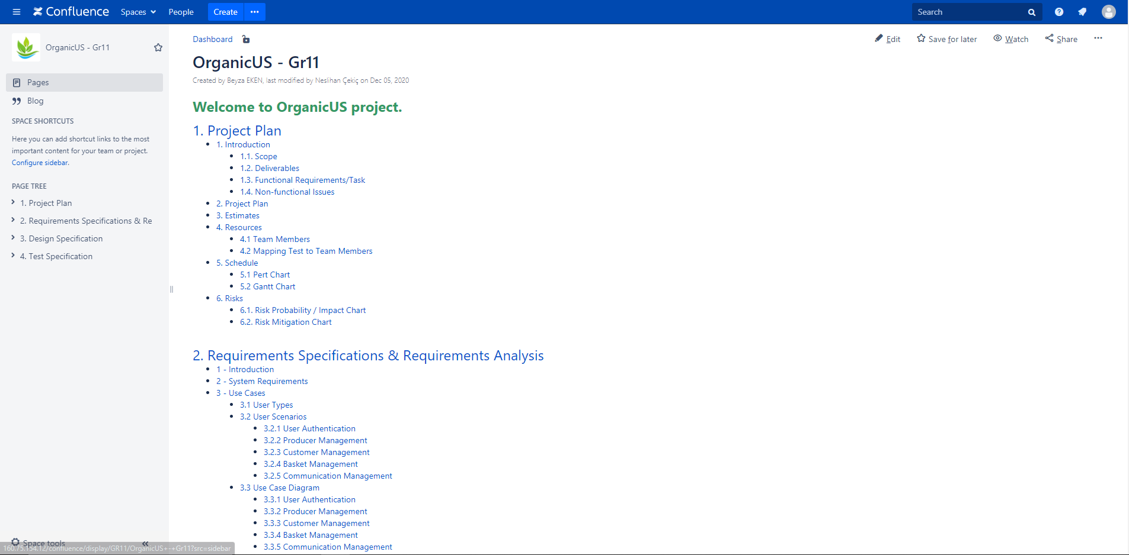
1.4.2) Confluence

Slide 12
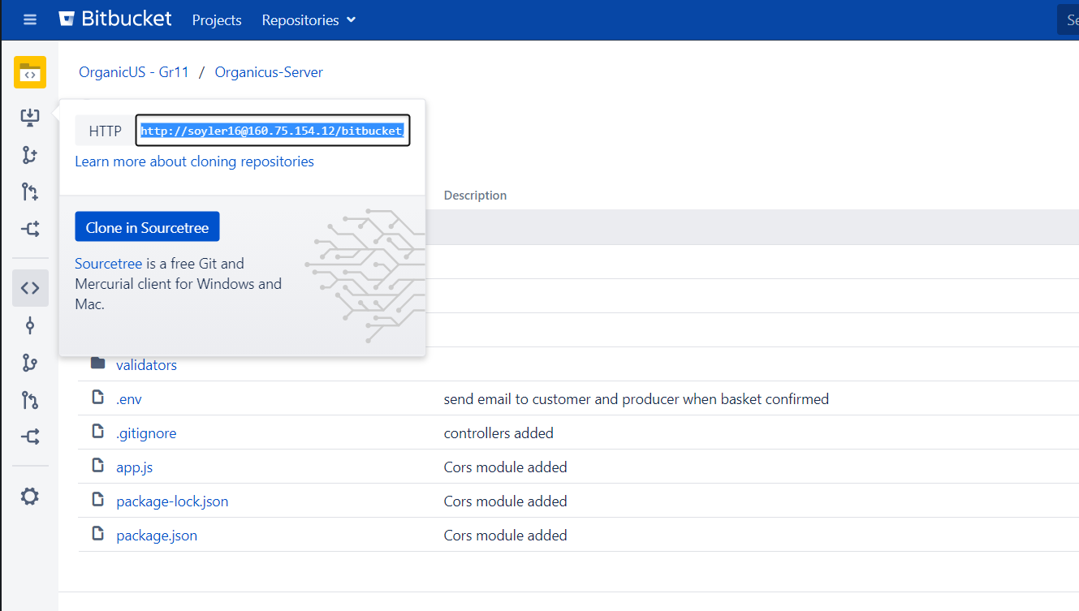
1.4.3) Bitbucket & SourceTree

Slide 13
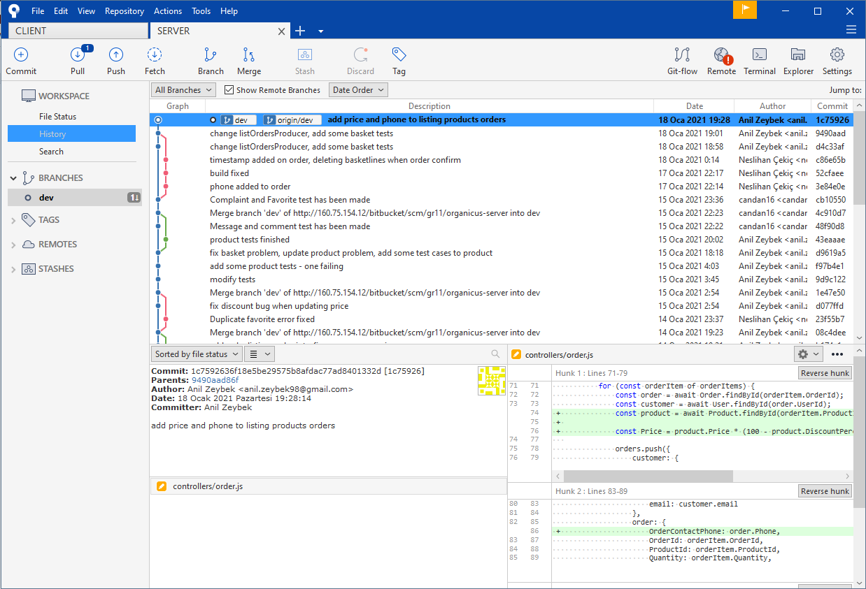
1.4.3) Bitbucket & SourceTree

Slide 14
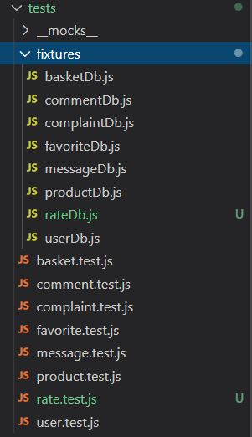
1.4.4) Jest & Supertest
The Jest and Supertest were used as a testing tools. In the same folder, tests folder and its template databases were created.
As a feature of the Jest tool, when we add .test.js to the test files we will create, it can be automatically detected as a test file. Afterwards, it can be concluded by running either test cases in a single test file or all test files in the terminal.
By including the Supertest tool, GET, POST, PUT, DELETE and PATCH methods can also be tested.

Slide 15
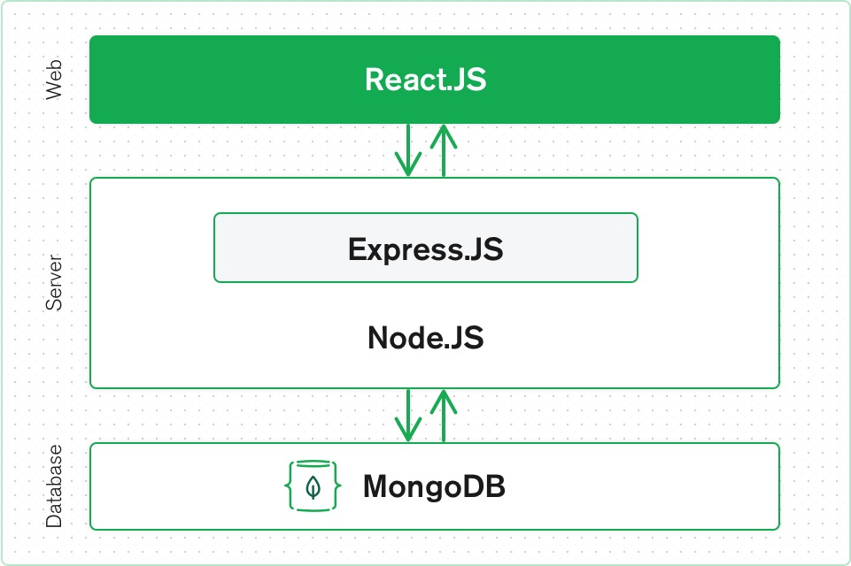
1.4.5) MERN
The MERN architecture allows you to easily construct a 3-tier architecture (frontend, backend, database) entirely using JavaScript and JSON.
Mongodb use for storage any kind of data.
Express and Node make up the middle (application) tier. Express.js is a server-side web framework, and Node.js the popular and powerful JavaScript server platform.
React.js is the declarative JavaScript framework for creating dynamic client-side applications in HTML. React lets you build up complex interfaces through simple Components, connect them to data on your backend server, and render them as HTML

Slide 16
1.5) Our Customer Meetings
We met three times with our customer, Beyza Eken, in two week interval on Fridays.
In first meeting, we informed our customer about how to build, what will be the purpose and who can use the platform.
In second meeting we informed our customer about the structure of the platform and explained the general flow of our platform by help of our diagrams.

Slide 17
1.5) Our Customer Meetings
In last meeting, our customer asked us if we can change the message system. She shared her thoughts with us about message system.
We convinced our customer that this change is against the purpose of our platform. We shared our thoughts also with her and said that existing system is more proper.
In conclusion, we did not make this change.

Slide 18
1.6) Test & Results
In the tests, firstly tests related to user login were prepared. Comprehensive user login and register cases have been arranged such as when users log in, register, authentication is progressing properly.
It was checked whether registered users have accessed the database.
In the project, which is about to close to the end, tests have been prepared based on the requirement analysis document we have prepared previously, such as whether customers' complaints have been received, their comments, ratings, and the status of favorite lists.

Slide 19
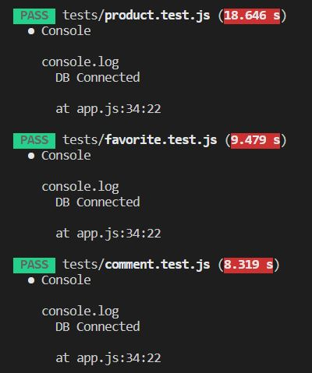
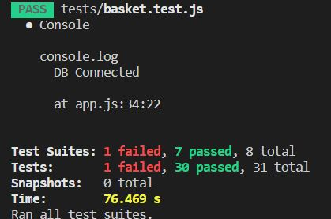
1.6) Test & Results
A few examples can also be cited here.

Slide 20
1.6) Test & Results
These test cases are reproduced and developed. Getting errors or failing the test is crucial to the successful arrival of the product without missing any points. For this reason, an example of the problem we encountered while preparing the test files was added. As these errors are detected, we aim to increase the quality of the product and customer satisfaction.

Slide 21
LIVE DEMO

